Slide 1
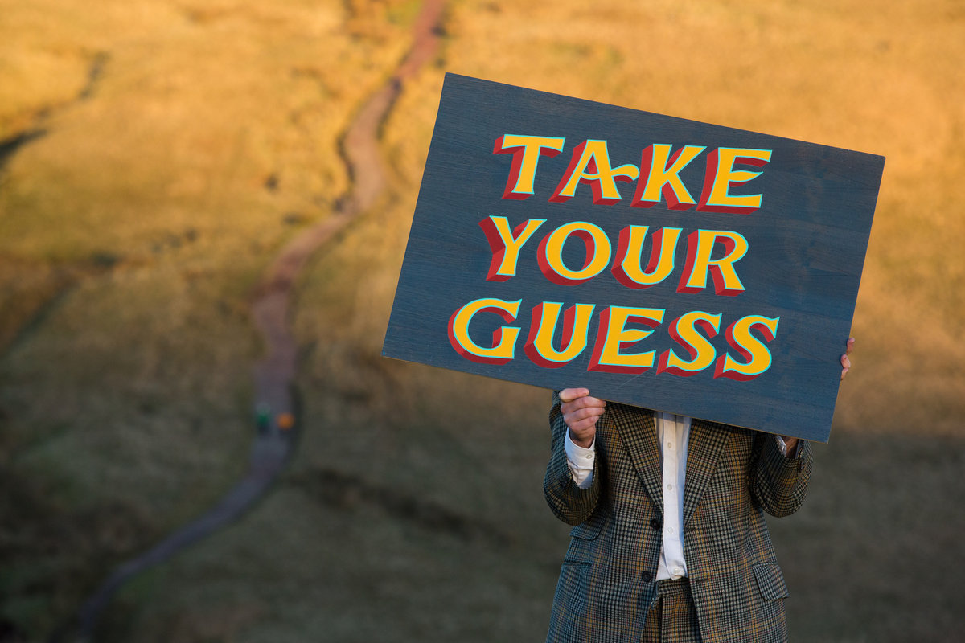

Slide 2
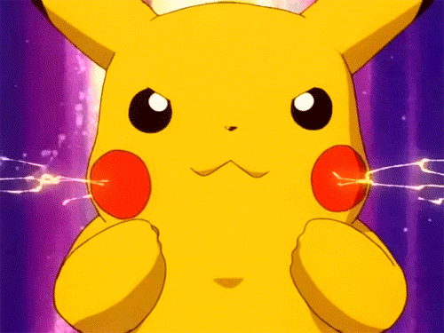
What does it look like?
1. It has a yellow, bald head.
2. It has round, black eyes.
3. It has a very small nose
and a Cupid’s Bow mouth.
4. It has long ears.
5. It has a lot of electricity.

Slide 3
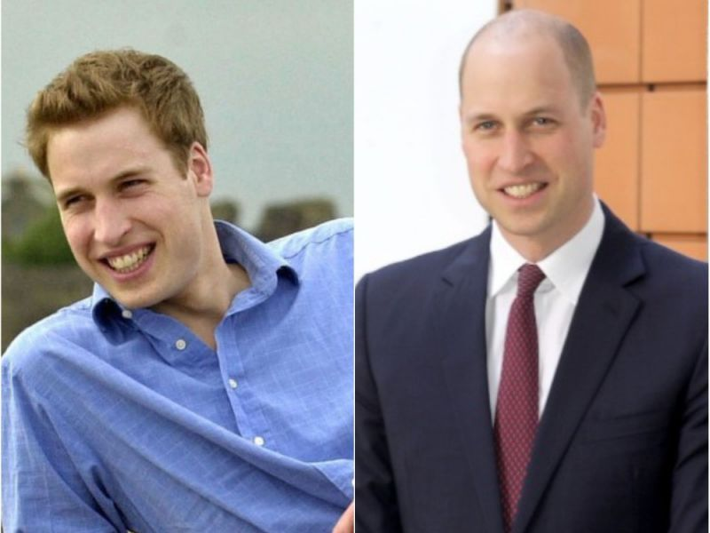
What does he look like?
1. He has a bald head.
2. He has big blue eyes.
3. He has a hawk nose and
a smiling big mouth.
4. He has normal ears.
5. His grandmother is a
queen.

Slide 4
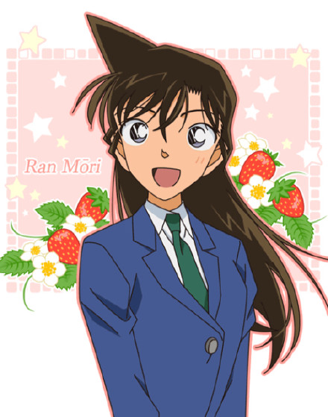
What does she look like?
She has long, straight, black hair and a sharp angle.
2. She has big, round, black
eyes.
3. She has a small nose and
a small mouth.
4. She’s a cartoon character
and a detective’s girlfriend.

Slide 5
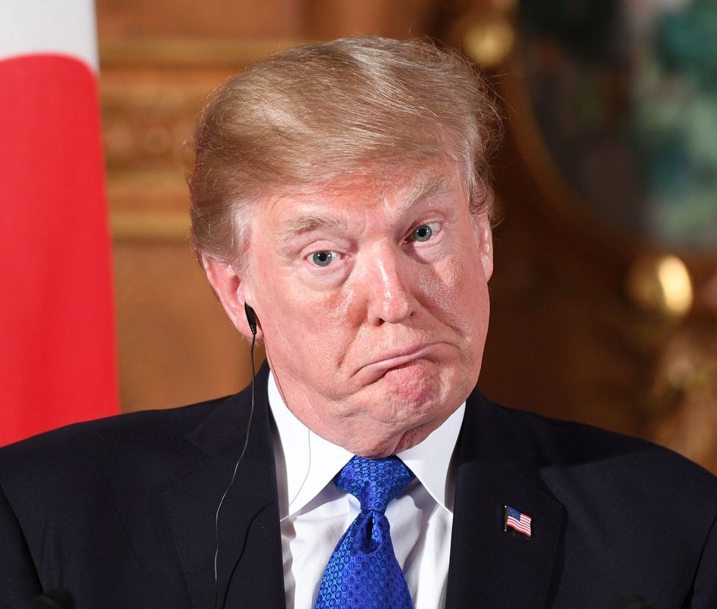
What does he look like?
1. He has short, straight,
blond hair.
2. He has green eyes.
3. He has a pointy nose and
a big, thin mouth.
4. He has big ears.
5. He’s a famous leader and
a businessman.

Slide 6
What does he look like?
He has short, straight,
black hair.
2. He has big, black eyes.
3. He has a big, round nose
and a glamour mouth.
4. He has big ears.
5. He’s a teacher, and
masters in baseball and
swimming.

Slide 7
What does she look like?
She has a medium length,
straight, black ponytail.
2. She has small black eyes.
3. She has a round nose and
a natural mouth.
4. She’s a teacher and loves
to see baseball games and
concerts.

Slide 8
